Slide 1

Bypass & Compression Ratio
Limiting Factors and Design Tradeoffs
Engineer Woiny Teka | Engineering | 12/16/2024

Slide 2
Bypass Ratio
Fan and Core Sizing, Propulsive Efficiency

Slide 3
Introduction & Key Concepts
Overview: Examining the trade-offs and design challenges related to bypass ratio and compression ratio.
Bypass Ratio: Affects fuel efficiency, engine size, and thrust.
Compression Ratio: Influences engine power output, fuel efficiency, and material stress.
Objective: Explore why and how design teams adjust these ratios for different aircraft types and mission profiles.

Slide 4

Compression Ratio
Compressor and Combustor, Thermal Efficiency

Slide 5

Reasons to Increase or Decrease Bypass Ratio
Increase Bypass Ratio:
Fuel Efficiency: Larger fans offer more efficient subsonic thrust (e.g., 737-800, A320).
Lower Emissions: Reduced fuel consumption leads to fewer emissions.
Trade-offs: Larger engine size, more drag, and weight.
Decrease Bypass Ratio:
Faster Speeds: Ideal for high-speed applications like military jets (e.g., F-35).
Performance: Smaller fans provide higher thrust-to-weight ratios for supersonic speeds.
Trade-offs: Lower fuel efficiency at subsonic speeds.

Slide 6
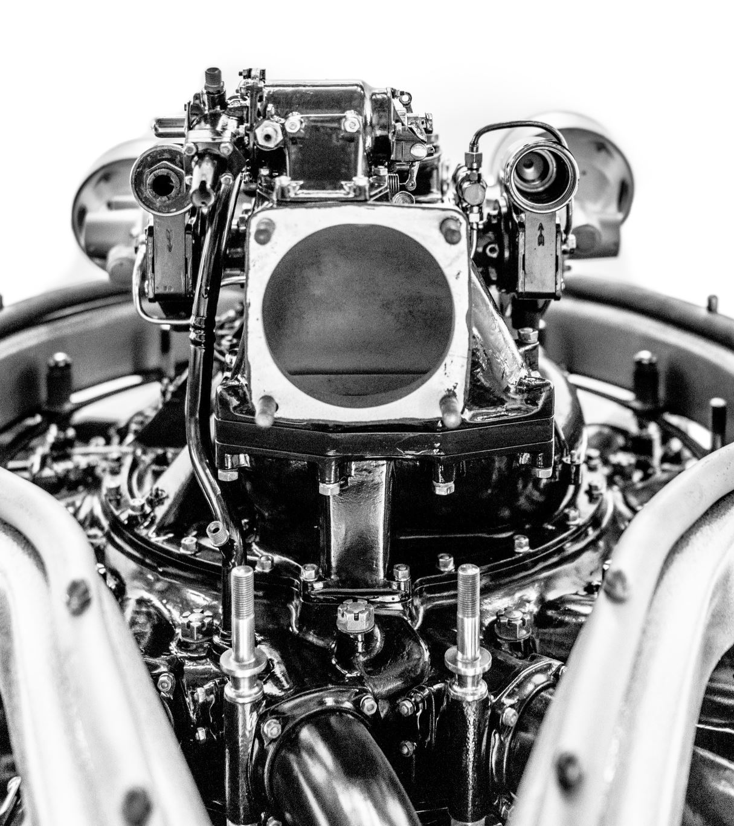
Tradeoffs in Engine Sizing
Compressor and Combustor, Thermal Efficiency

Slide 7

Limitations of Increasing Bypass Ratio
Fan Diameter: Larger fans increase drag, aircraft weight, and structural complexity.
Weight and Drag: Larger engines require more structural support, impacting aircraft performance and fuel efficiency.
Aircraft Size Constraints: Larger engines may require modifications to existing aircraft designs, impacting aerodynamics and overall cost.

Slide 8
Limiting Factors for Compression Ratio
Material Strength: Higher compression ratios result in higher pressures and temperatures, requiring advanced, heat-resistant materials (e.g., titanium alloys, ceramics).
Temperature Management: Increased compression leads to higher combustion temperatures, which can increase NOx emissions.
Cooling Needs: Engines with higher compression ratios require advanced cooling systems to prevent overheating and material failure.

Slide 9
Conclusion & Design Considerations
Key Trade-offs:
Bypass Ratio: Increases efficiency but comes with challenges in size, weight, and drag.
Compression Ratio: Improves fuel efficiency and power but requires robust materials and advanced cooling.
Next Steps: Investigate advanced materials, fuel efficiency technologies, and emission control innovations to balance these factors for sustainable next-gen propulsion systems.

